Slide 1
Digital Platform Take Home Assessment
Aziz Akhtar
Overview
In this challenge, you’ll demonstrate your ability to consolidate data, uncover patterns, derive insights, and propose solutions to business challenges. You’ll work with three datasets containing trends and complexities designed to mimic real-world scenarios. Your goal is to process the data, analyze it, and provide actionable recommendations supported by your findings.
Scenario
Company A’s leadership team is seeking insights to drive strategic decision-making and operational improvements. They have provided you with three datasets:
User Activity Data: Captures details about user sessions, including session length, messages sent, feedback ratings, and resources clicked.
Moderator Performance Data: Tracks metrics like sessions moderated, average response times, and user satisfaction scores.
Recommendation Data: Includes data on recommendation types, click-through rates, and feedback scores.
The leadership team has not defined specific metrics or questions. It is up to you to identify key trends, anomalies, and insights that are most impactful for the business.

Slide 2
Your Tasks
Download the data from here
Ingest and Transform: ○ Load and clean the datasets to prepare them for analysis. ○ Consolidate the data into a unified model that allows cross-dataset exploration (e.g., linking user sessions to recommendations or moderator performance).
Analyze: Explore the data to identify trends, patterns, and relationships across the datasets.
Define and calculate any metrics or KPIs that you think are relevant for measuring user engagement, moderator performance, or recommendation effectiveness.
Identify anomalies or areas for improvement.
Answer Broad Questions:
What key insights can you uncover from the data?
How would you measure engagement or effectiveness across these datasets?
What trends or patterns stand out to you, and why are they important?
Are there any areas of concern or anomalies that require attention? ○ Based on your findings, what recommendations would you make to improve platform performance or user experience?
Visualize and Report:
Create visualizations to highlight your findings using freely available tools such as Google Sheets, Excel, or Python libraries (e.g., Matplotlib, etc).
Develop a concise report (~1-2 pages) summarizing your findings, insights, and recommendations.

Slide 3
Submission Guidelines
Share your code or steps used for data processing and analysis (e.g., Python scripts, SQL queries). Include screenshots, exported graphs, or files showing your visualizations.
Provide a write-up summarizing your insights and recommendations.
Evaluation Criteria
Critical Thinking: How well did you interpret the business problem and address it with data?
Technical Execution: Quality of your data transformations and metric definitions.
Clarity: Are your insights and recommendations well-articulated and actionable?
Creativity: Innovative approaches to solving the problem or presenting data.
I confirm artificial intelligence was not used for this analysis – Aziz Akhtar

Slide 4
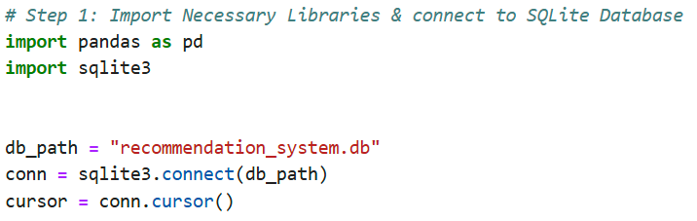
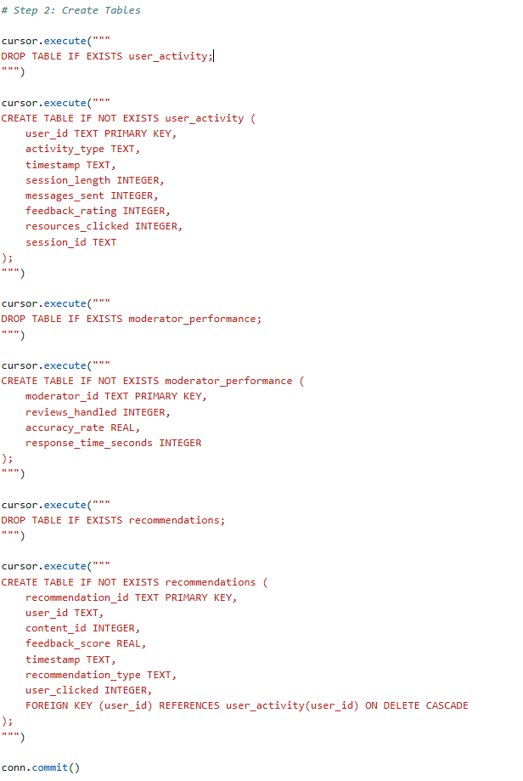
Setting up the data
Note* Pasting code to ensure it is visible during presentation
Step 1 – Import Necessary Libraries and establish database connection
First, we need pandas for data handling and sqlite3 to interact with the database.
Step 2 – Create data model schema
Next, analyze the data, create the schema to properly load the values
# Step 2a: Create Tables
# User Activity Table
cursor.execute
("""DROP TABLE IF EXISTS user_activity;""")
cursor.execute
("""CREATE TABLE IF NOT EXISTS user_activity
( user_id TEXT PRIMARY KEY,
activity_type TEXT,
timestamp TEXT,
session_length INTEGER,
messages_sent INTEGER,
feedback_rating INTEGER,
resources_clicked INTEGER,
session_id TEXT);""")
# Step 2b: Create Tables
# Recommendations Table
cursor.execute
("""DROP TABLE IF EXISTS recommendations;""")
cursor.execute
("""CREATE TABLE IF NOT EXISTS recommendations
( recommendation_id TEXT PRIMARY KEY, user_id TEXT, content_id INTEGER, feedback_score REAL,
timestamp TEXT, recommendation_type TEXT, user_clicked INTEGER,
FOREIGN KEY (user_id) REFERENCES user_activity(user_id) ON DELETE CASCADE);""")conn.commit()
# Step 2c: Create Tables
# Moderator Performance Table
cursor.execute
("""DROP TABLE IF EXISTS
moderator_performance;""")
cursor.execute
("""CREATE TABLE IF NOT EXISTS moderator_performance (
moderator_id TEXT PRIMARY KEY,
reviews_handled INTEGER, accuracy_rate REAL, response_time_seconds INTEGER);""")
#confirm changes
conn.commit()

Slide 5
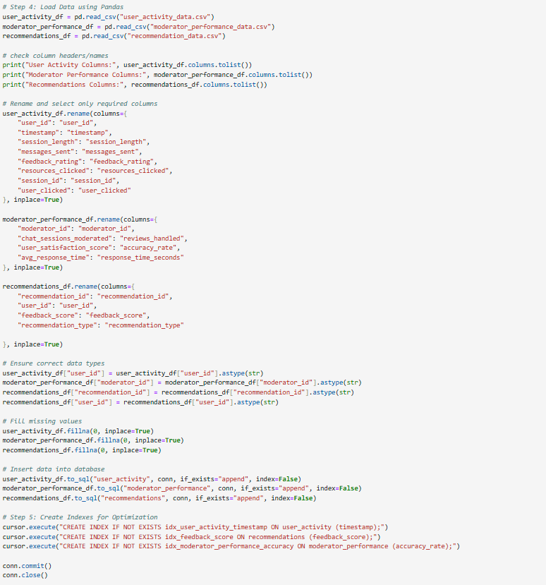
Inserting the data
Note* Pasting code to ensure it is visible during presentation
Step 3 – Load values into tables
# Step 3 – Load Data from flat files provided in email using Pandas
user_activity_df = pd.read_csv("user_activity_data.csv“)
moderator_performance_df = pd.read_csv("moderator_performance_data.csv“)
recommendations_df = pd.read_csv("recommendation_data.csv")
# Check column headers/names
print("User Activity Columns:", user_activity_df.columns.tolist())
print("Moderator Performance Columns:", moderator_performance_df.columns.tolist())
print("Recommendations Columns:", recommendations_df.columns.tolist())
# Ensure correct data types
user_activity_df["user_id"] = user_activity_df["user_id"].astype(str)
moderator_performance_df["moderator_id"] = moderator_performance_df["moderator_id"].astype(str)
recommendations_df["recommendation_id"] = recommendations_df["recommendation_id"].astype(str)
recommendations_df["user_id"] = ecommendations_df["user_id"].astype(str)
# Fill missing values
user_activity_df.fillna(0, inplace=True)
moderator_performance_df.fillna(0, inplace=True)
recommendations_df.fillna(0, inplace=True)
# Insert data into database
user_activity_df.to_sql("user_activity", conn, if_exists="append", index=False)
moderator_performance_df.to_sql("moderator_performance", conn, if_exists="append", index=False)
recommendations_df.to_sql("recommendations", conn, if_exists="append", index=False)
# Create Indexes for Optimization
cursor.execute("CREATE INDEX IF NOT EXISTS idx_user_activity_timestamp ON user_activity (timestamp);")
cursor.execute("CREATE INDEX IF NOT EXISTS idx_feedback_score ON recommendations (feedback_score);")
cursor.execute("CREATE INDEX IF NOT EXISTS idx_moderator_performance_accuracy ON moderator_performance (accuracy_rate);")
conn.commit()
conn.close()
Fixed column mismatches by renaming columns to match the database schema.
Ensured UUIDs are stored as strings and converted appropriately.
Handled missing values by filling them with zero.
Added indexes for performance optimization.

Slide 6
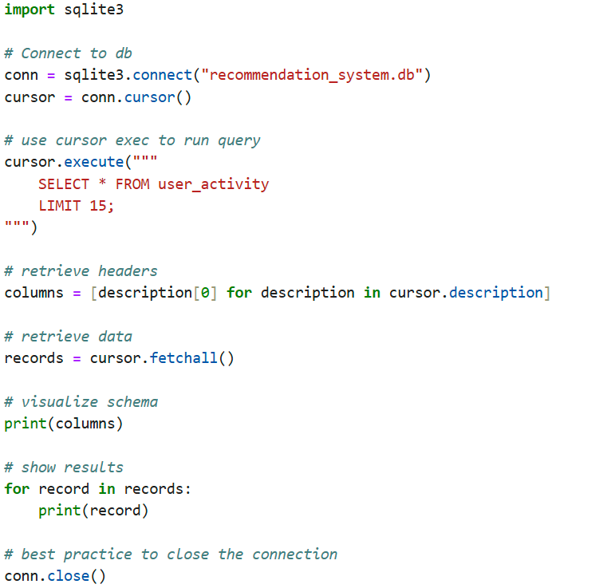
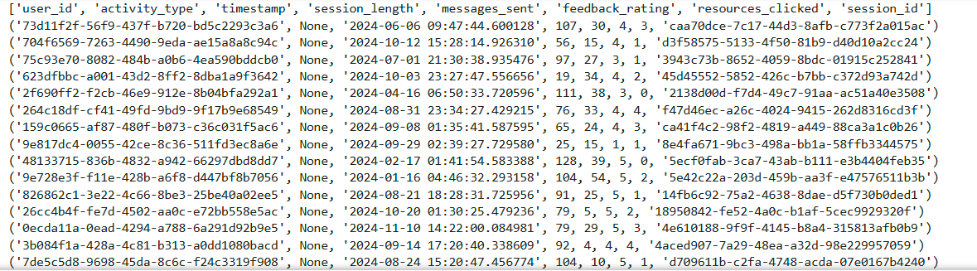
Query tables
Note* Pasting code to ensure it is visible during presentation
Step 4 – Ensure querying tables is working properly and schema/values are setup correctly
import sqlite3#
Connect to dbconn = sqlite3.connect("recommendation_system.db")
cursor = conn.cursor()
cursor.execute
(""" SELECT * FROM user_activity LIMIT 15;""")
# retrieve headers
columns = [description[0] for description in cursor.description]
# retrieve data
records = cursor.fetchall()
# visualize schema
print(columns)
# show results
for record in records: print(record)
conn.close()

Slide 7
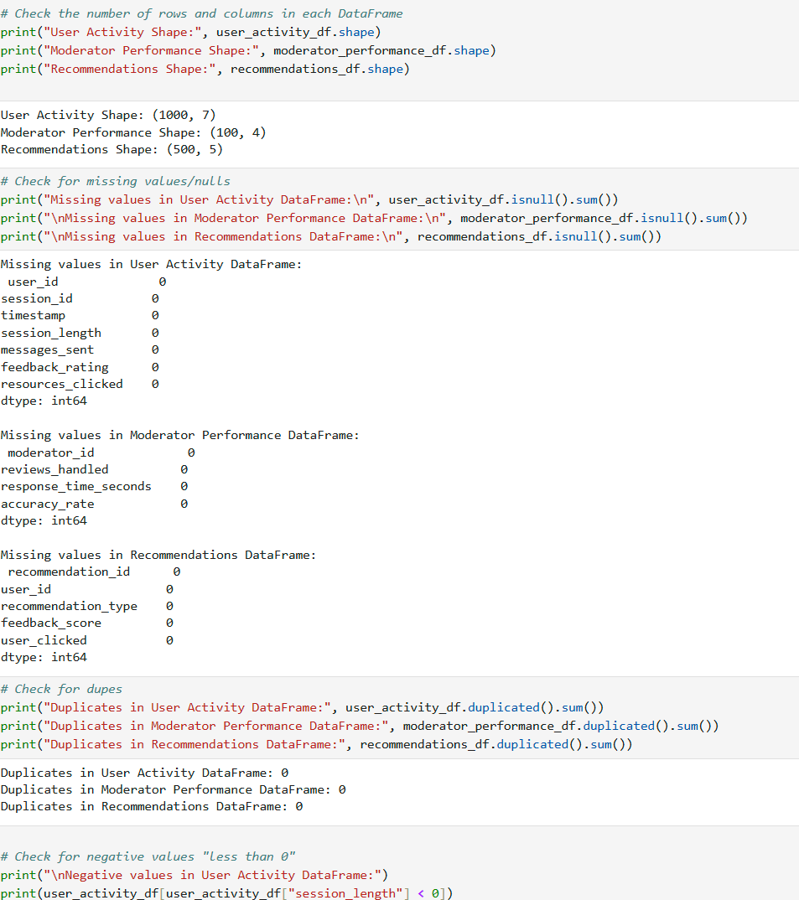
Data Quality Check
Note* Pasting code to ensure it is visible during presentation
Step 5 – Data quality checks
# Check the number of rows and columns in each DataFrame
print("User Activity Shape:", user_activity_df.shape)
print("Moderator Performance Shape:", moderator_performance_df.shape)
print("Recommendations Shape:", recommendations_df.shape)
# Check for missing values/nulls
print("Missing values in User Activity DataFrame:\n", user_activity_df.isnull().sum())
print("\nMissing values in Moderator Performance DataFrame:\n", moderator_performance_df.isnull().sum())
print("\nMissing values in Recommendations DataFrame:\n", recommendations_df.isnull().sum())
# Check for dupes
print("Duplicates in User Activity DataFrame:", user_activity_df.duplicated().sum())print("Duplicates in Moderator Performance DataFrame:", moderator_performance_df.duplicated().sum())print("Duplicates in Recommendations DataFrame:", recommendations_df.duplicated().sum())
# Check for invalid values in Recommendations
print("\nNegative values in Recommendations DataFrame:")print(recommendations_df[recommendations_df["feedback_score"] < 0])
# Check for duplicate IDs in each table for the indexes made
print("\nDuplicate user_ids in User Activity DataFrame:", user_activity_df["user_id"].duplicated().sum())
print("Duplicate moderator_ids in Moderator Performance DataFrame:", moderator_performance_df["moderator_id"].duplicated().sum())
print("Duplicate recommendation_ids in Recommendations DataFrame:", recommendations_df["recommendation_id"].duplicated().sum())
# Summarize data quality
summarize_data_quality(user_activity_df, "User Activity")
summarize_data_quality(moderator_performance_df, "Moderator Performance")
summarize_data_quality(recommendations_df, "Recommendations")

Slide 8
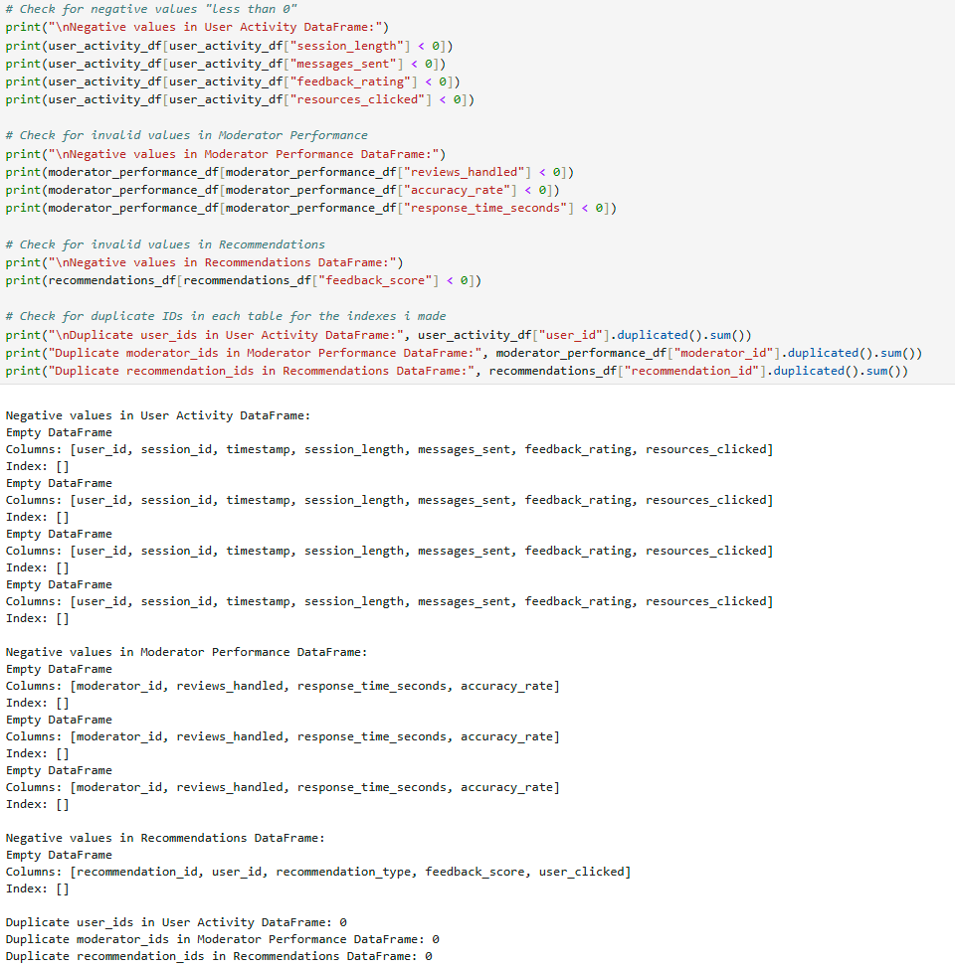
Continued…
Note* Pasting code to ensure it is visible during presentation
Step 5 – Data quality checks
# Check for negative values "less than 0"print("\nNegative values in User Activity DataFrame:")print(user_activity_df[user_activity_df["session_length"] < 0])print(user_activity_df[user_activity_df["messages_sent"] < 0])print(user_activity_df[user_activity_df["feedback_rating"] < 0])print(user_activity_df[user_activity_df["resources_clicked"] < 0])
# Check for invalid values in Recommendations
print("\nNegative values in Recommendations DataFrame:")print(recommendations_df[recommendations_df["feedback_score"] < 0])
# Check for duplicate IDs in each table for the indexes made
print("\nDuplicate user_ids in User Activity DataFrame:", user_activity_df["user_id"].duplicated().sum())
print("Duplicate moderator_ids in Moderator Performance DataFrame:", moderator_performance_df["moderator_id"].duplicated().sum())
print("Duplicate recommendation_ids in Recommendations DataFrame:", recommendations_df["recommendation_id"].duplicated().sum())
# Summarize data quality
summarize_data_quality(user_activity_df, "User Activity")
summarize_data_quality(moderator_performance_df, "Moderator Performance")
summarize_data_quality(recommendations_df, "Recommendations")

Slide 9
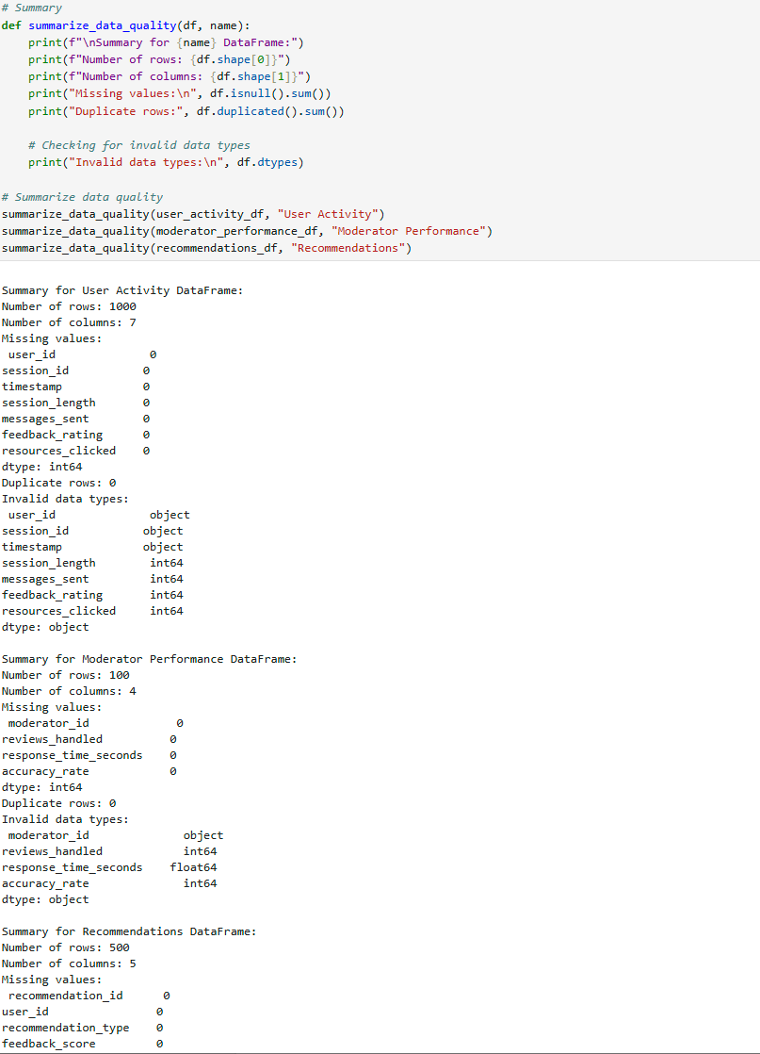
Data Quality Summary
Note* Pasting code to ensure it is visible during presentation
Step 5 – Data quality checks
# Summarize data quality
summarize_data_quality(user_activity_df, "User Activity")
summarize_data_quality(moderator_performance_df, "Moderator Performance")
summarize_data_quality(recommendations_df, "Recommendations")
Conclusion –
Data integrity not compromised, no dupes, no missing values, schema fits the values properly in pandas.

Slide 10
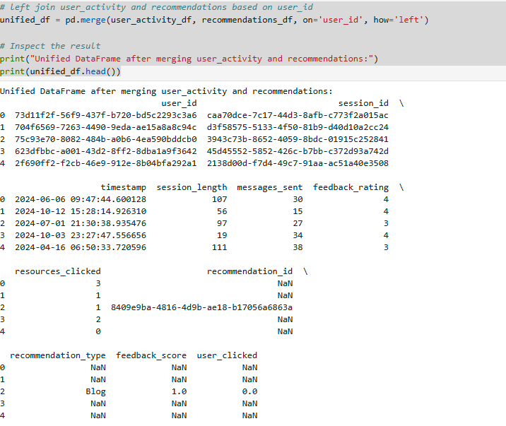
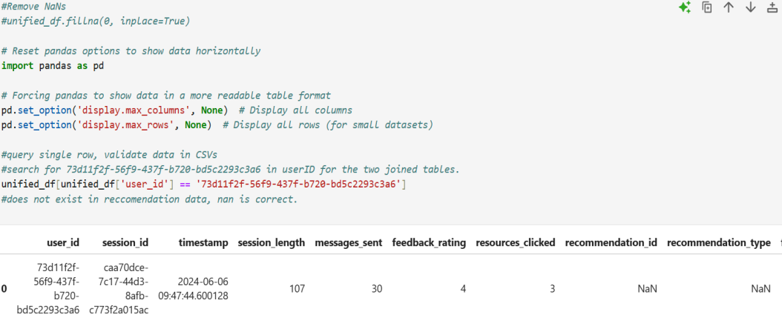
Merge tables with join
Note* Pasting code to ensure it is visible during presentation
Step 5 – Data quality checks
# Left join user_activity and recommendations based on user_id
unified_df = pd.merge(user_activity_df, recommendations_df, on='user_id', how='left')
# Examine data frames after join
print("Unified DataFrame after merging user_activity and recommendations:")
print(unified_df.head())
# Reset pandas options to show data horizontally
import pandas as pd
# Forcing pandas to show data in a more readable table format
pd.set_option('display.max_columns', None)
pd.set_option('display.max_rows', None)
# Display all rows (for small datasets)#query single row, validate data in CSVs
#search for 73d11f2f-56f9-437f-b720-bd5c2293c3a6 in userID for the two joined tables.
unified_df[unified_df['user_id'] == '73d11f2f-56f9-437f-b720-bd5c2293c3a6']
# result – does not exist in recommendation data, nan is correct.

Slide 11
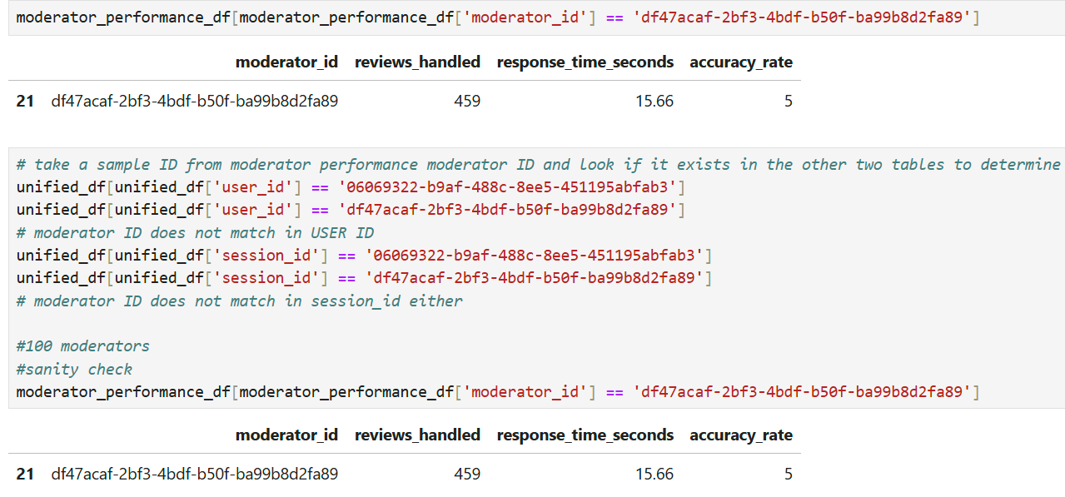
Continuted…
Note* Pasting code to ensure it is visible during presentation
Step 5 – Data quality checks
# take a sample ID from moderator performance moderator ID and look if it exists in the other two tables to determine join
unified_df[unified_df['user_id'] == '06069322-b9af-488c-8ee5-451195abfab3']
unified_df[unified_df['user_id'] == 'df47acaf-2bf3-4bdf-b50f-ba99b8d2fa89']
# moderator ID does not match in USER ID
unified_df[unified_df['session_id'] == '06069322-b9af-488c-8ee5-451195abfab3']
unified_df[unified_df['session_id'] == 'df47acaf-2bf3-4bdf-b50f-ba99b8d2fa89'] # moderator ID does not match in session_id either
#100 total moderators
#sanity check
moderator_performance_df[moderator_performance_df['moderator_id'] == 'df47acaf-2bf3-4bdf-b50f-ba99b8d2fa89']

Slide 12
KPIs
Avg Session Length | 64.601
Avg Messages Sent per Session | 28.49
Avg Feedback Rating | 3.404
Avg Resources Clicked per Session | 2.101
Avg Reviews Handled per Moderator | 245.44
Avg Response Time of Moderators | 11.3643
Avg Accuracy Rate of Moderators | 3.1
These KPIs can be used to determine the norms of user engagement(messages, clicks), moderator efficiency(speed, accuracy) and user satisfaction(feedback score). If the data is loaded frequently, averages will change, it would be wise to store historical data to compare rolling averages QoQ or MoM for board meetings.

Slide 13
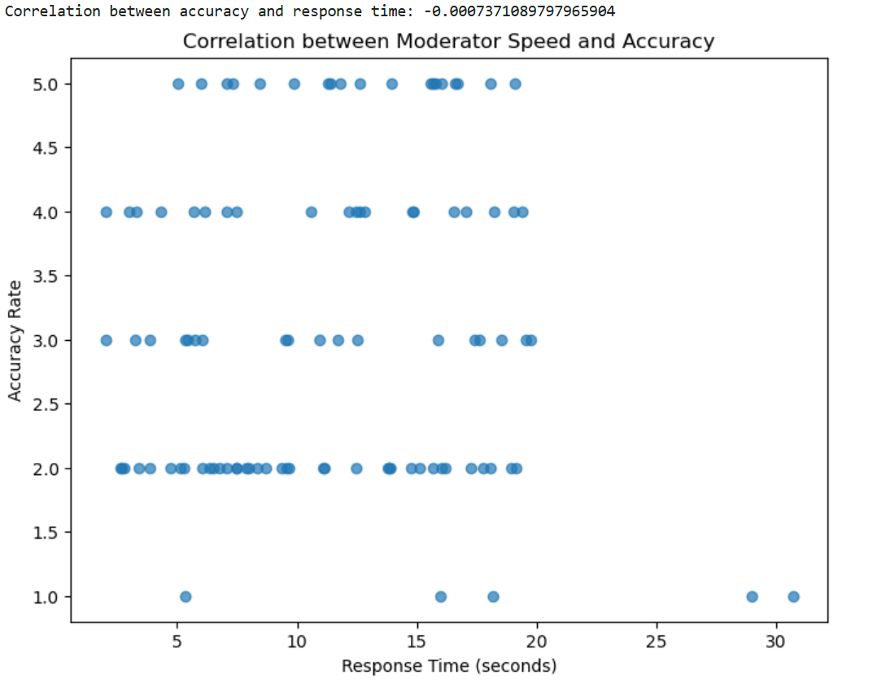
Moderator Efficiency
Accuracy usually decreases when actions are performed in haste. Moderators which had faster response times slightly resulted in lower accuracy. The correlation value of -0.0007 is not that strong, meaning we can set more achievable goals for the lower performing moderators, or hire talent that can be assessed against our top performers.

Slide 14
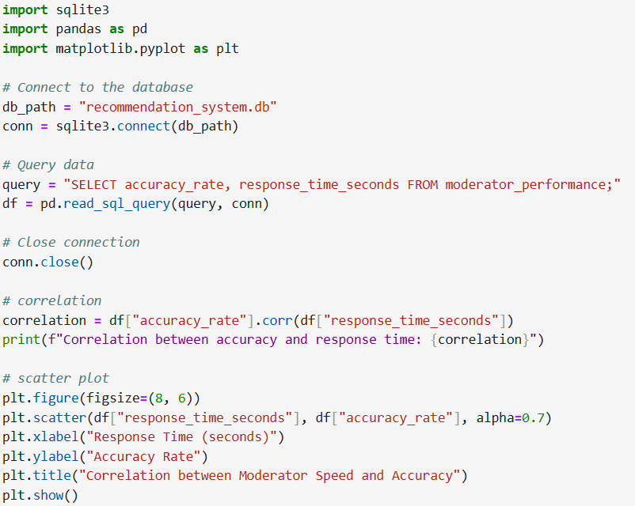
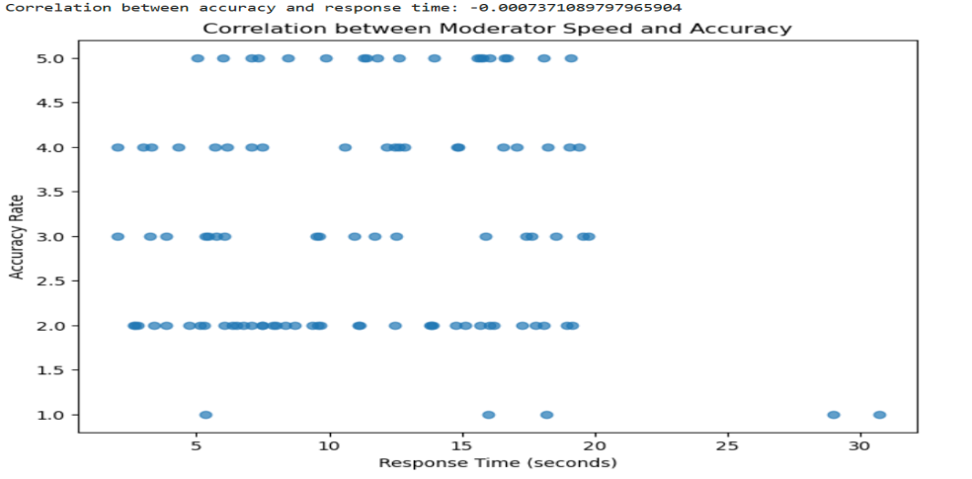
Moderator Efficiency Code

Slide 15
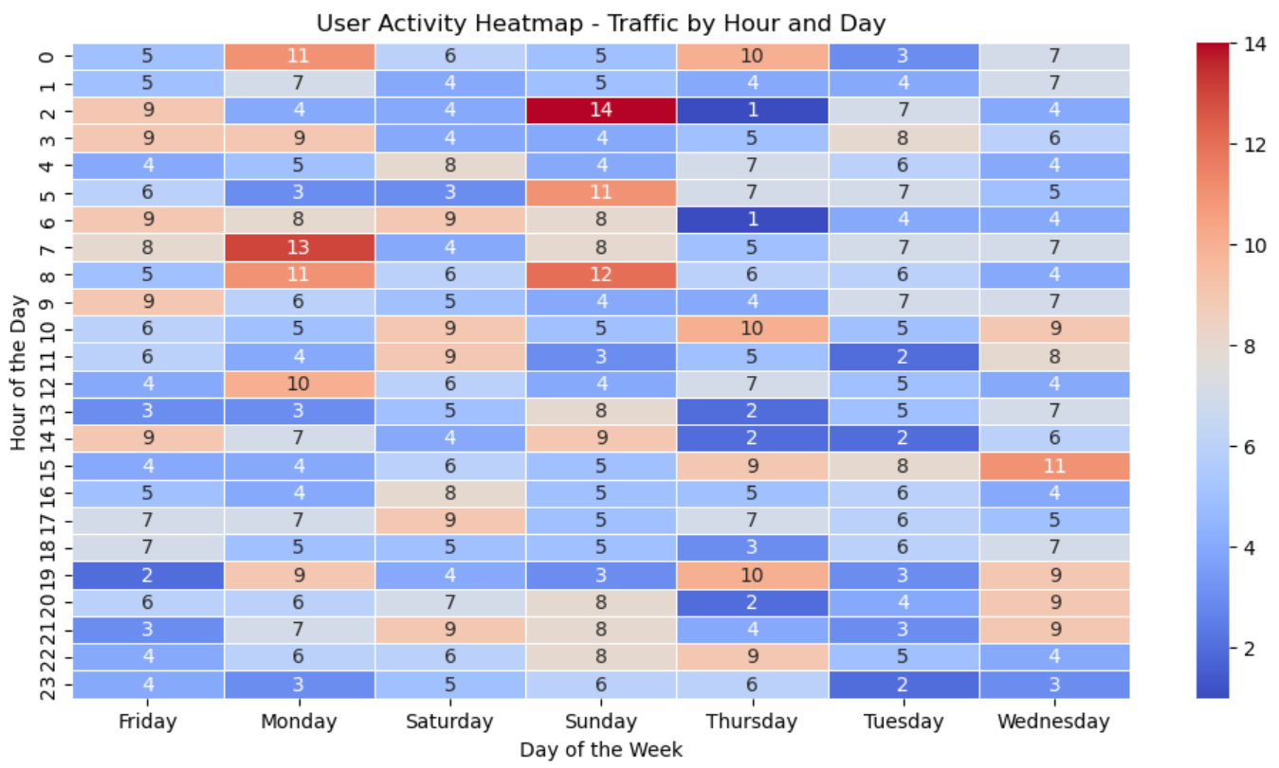
Workforce Optimization
We can use this heat map to figure out how to optimize our workforce, and when additional staff may be needed for busier days. We can also scale our technical environment based on expected traffic.

Slide 16

Workforce Optimization
We can use this heat map to figure out how to optimize our workforce, and when additional staff may be needed for busier days.
The highest traffic (14) occurs on Sunday at 3 AM.
Other high-activity periods include Monday at 7 AM (13) and Sunday at 9 AM (12).
There are moderate activity spikes across different times but particularly in the early morning and late evening.
There are several low-activity hours scattered throughout, particularly weekday afternoons and late nights.
The lowest recorded values appear in the early morning hours on weekdays.
Day-wise Traffic Trends:
Sunday and Monday show higher variability with both peak and low values.
Tuesday and Wednesday exhibit more uniform, lower traffic.
Friday and Saturday have relatively moderate and stable activity levels.

Slide 17
Continued with Recommendations
We can use this heat map to figure out how to optimize our workforce, and when additional staff may be needed for busier days.
Optimize Staffing and Resources Based on Activity Levels:
Ensure higher availability of support/resources on Sunday early mornings and Monday mornings to manage peak loads.
Reduce staffing/resource allocation during low-traffic periods to improve cost efficiency.
Targeted Engagement and Campaigns:
Consider special promotions or content releases on Sunday and Monday mornings to leverage high traffic.
Run engagement campaigns or incentives on Tuesday and Wednesday to improve activity on those lower-traffic days.
Infrastructure and System Scaling:
Optimize server capacity or cloud resources to handle peak load times efficiently.
Reduce operational costs by scaling down resources during low-traffic periods.

Slide 18
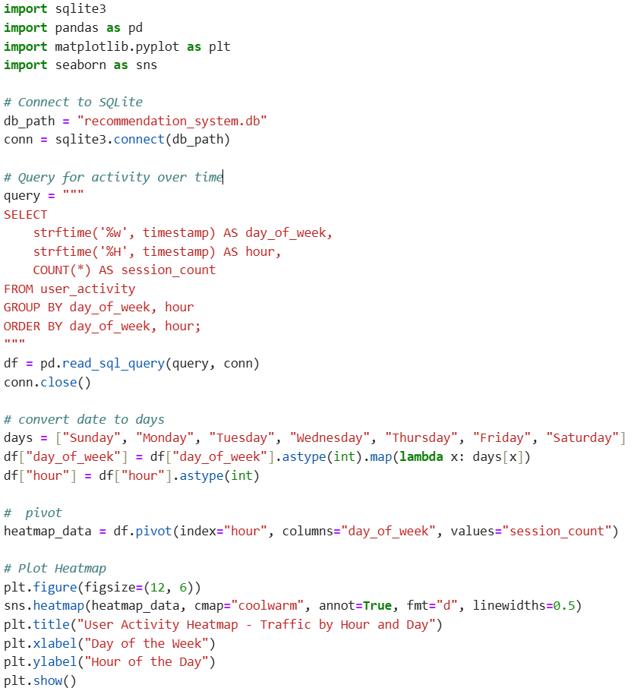
Heatmap Code

Slide 19
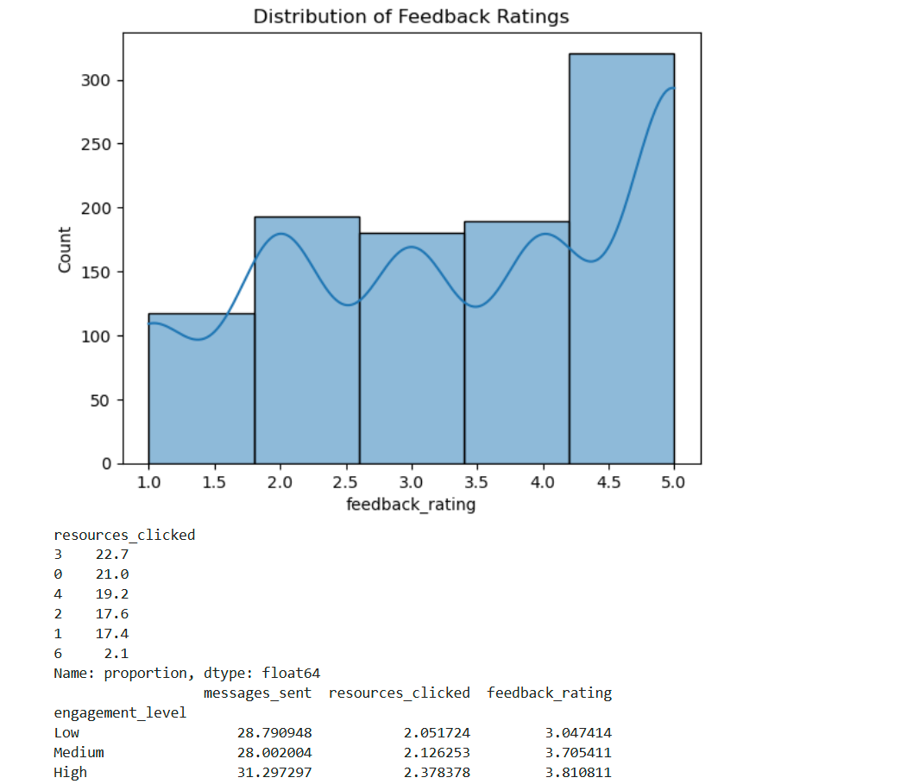
Distribution Analysis
Positive reviews:
Majority of the users are satisfied with the platform, as evidenced by the high concentration of ratings between 3.0 and 5.0.
Engagement makes a difference:
Higher engagement correlates with higher satisfaction. Users who spend more time on the platform and interact more tend to rate it better.
Resource Utilization:
Users typically interact with 2–4 resources per session. Greater than six is rare, suggesting room for improvement in resource discovery.
Low Engagement Users:
Users with low engagement (shorter sessions, fewer interactions) are less satisfied. Monitoring user’s low engagement and incentivizing them by personalized notifications or recommendations could drive engagement higher.

Slide 20
Distribution Analysis Recommendations
Improve Resource Discovery:
Make resources more visible or personalized to encourage users to explore more.
Boost Engagement:
Implement features like reminders, notifications, or personalized recommendations to increase session length and interactions.
Target and Incentivize Low Engagement Users:
Provide additional support or incentives to encourage low-engagement users to interact more with the platform.

Slide 21
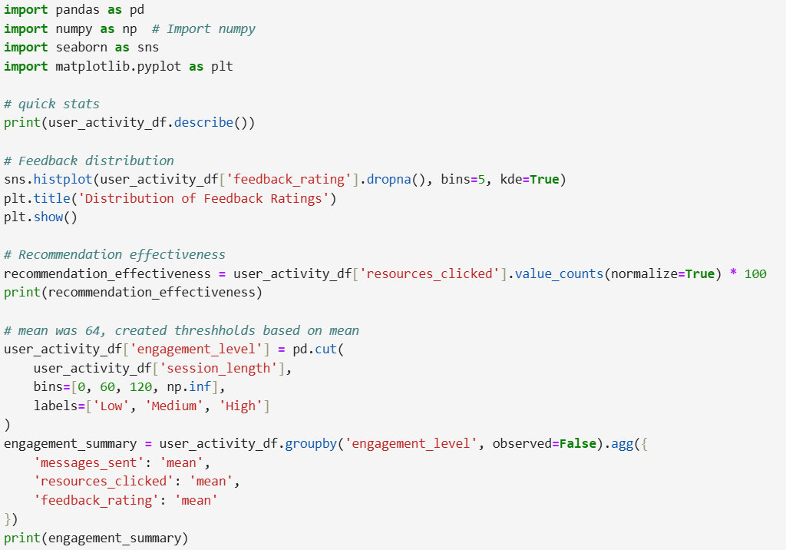
Distribution Analysis Code

Slide 22
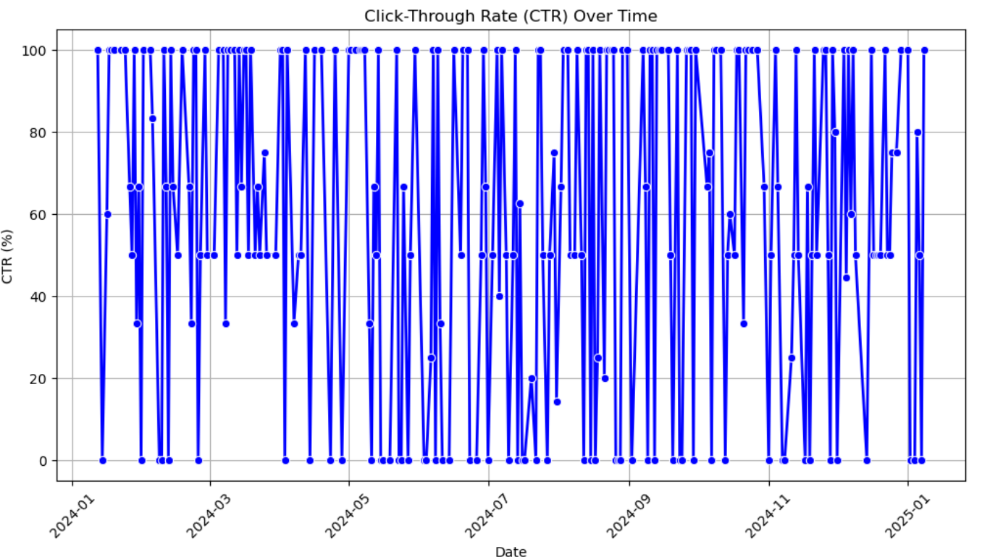
CTR Over Time
There aren't significant trends apparent within the click through rates. As we know engagement drives clicks and satisfaction. I would try to merge this data with customer attributes and persona’s to uncover trends within customer segments.

Slide 23
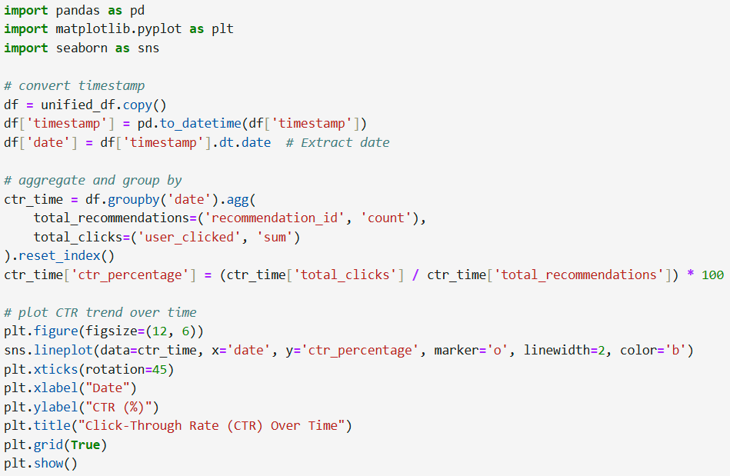
CTR Over Time Code

Slide 24
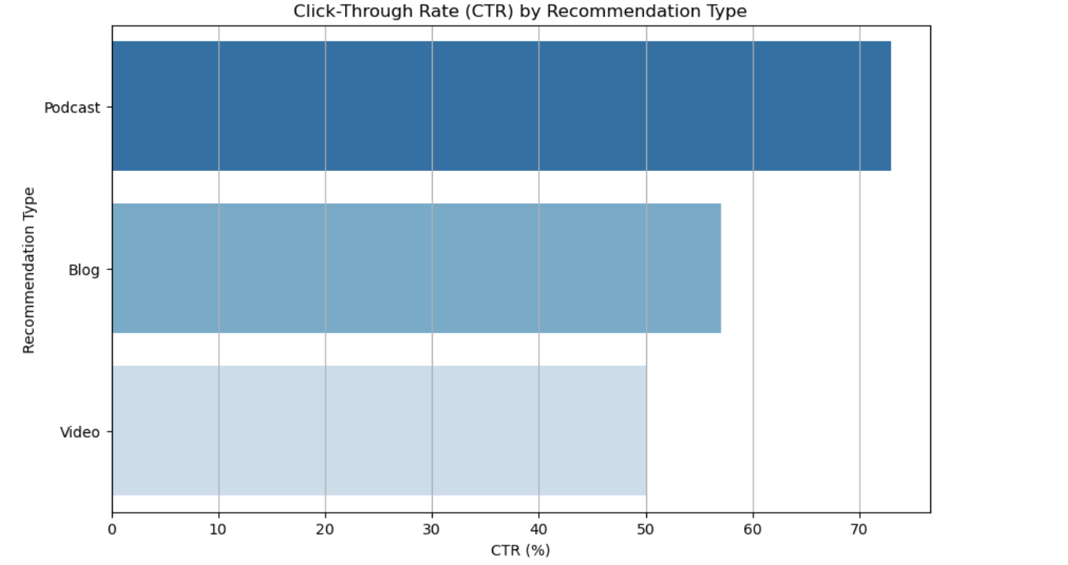
CTR by Recommendation Source
I would advocate for additional podcast resources since it is the top performer. I would try experimenting with different video lengths or authors to see if it drives additional engagement.

Slide 25
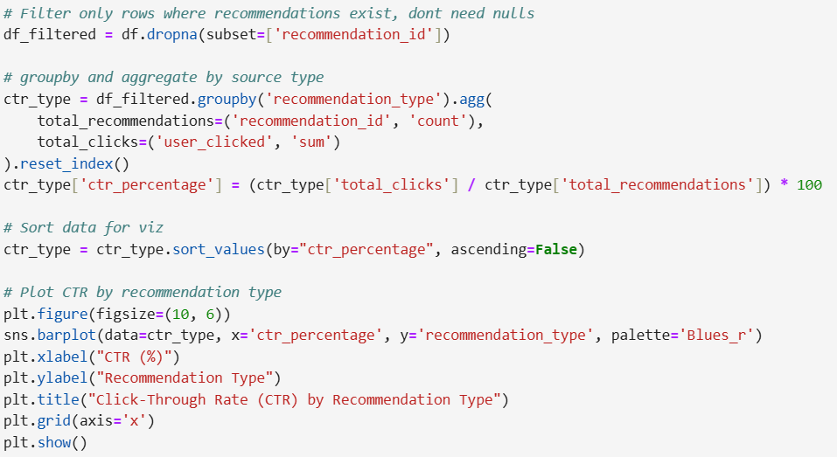
CTR by Recommendation Source

Slide 26
Q&A
What key insights can you uncover from the data?
I can determine the busiest days in terms of website traffic, which allows us to scale cloud infrastructure/backend to handle load and reduce delays for application users.
I can optimize staffing to ensure we have additional resources on the busier days, and shift the resources schedules more efficiently.
I can determine a health check of the application in regards to performance, the sample data indicated it is performing well as majority of the feedback is frequently greater than the average rating.
There is room for improvement for the moderators, as the correlation between moderator efficiency is indicative of room for improvement.
How would you measure engagement or effectiveness across these datasets?
Engagement is measured by clicks and interactions such as messages sent.
Engagement effectiveness can be determined by examining the click through rates in respect to the recommendation type provided.
Users engage more when provided with Podcasts and Blog resources. I would explore options pertaining to whether the videos we recommend are too long or have technical difficulties.

Slide 27
Q&A
Are there any areas of concern or anomalies that require attention?
Majority of the ratings are 3-5, I would further analyze the lower ratings and determine why their engagement is so low. I would try to see if they are bots or spam.
I would take a closer look at the resources clicked between 0-3 to see if there is any room for improvement for those users.
I would advocate for additional podcast resources since it is the top performer. I would try experimenting with different video lengths or authors to see if it drives additional engagement.
There aren't significant trends apparent within the click through rates. As we know engagement drives clicks and satisfaction. I would try to merge this data with customer attributes and persona’s to uncover trends within customer segments.
What trends or patterns stand out to you, and why are they important?
Users with low engagement (shorter sessions, fewer interactions) are less satisfied.
Monitor user’s low engagement and incentivize them with personalized notifications or recommendations to encourage higher engagement. Higher engagement correlates with higher satisfaction. Users who spend more time on the platform and interact more tend to rate it better.
Majority of the users are satisfied with the platform, as evidenced by the high concentration of ratings between 3.0 and 5.0.
Sunday and Monday show higher variability with both peak and low values. Tuesday and Wednesday exhibit more uniform, lower traffic. Friday and Saturday have relatively moderate and stable activity levels

Slide 28
Q&A
Based on your findings, what recommendations would you make to improve platform performance or user experience?
Make resources more visible or personalized to encourage users to explore more.
Implement features like reminders, notifications, or personalized recommendations to increase session length and interactions.
Provide additional support or incentives to encourage low-engagement users to interact more with the platform.
Ensure higher availability of support/resources on Sunday early mornings and Monday mornings to manage peak loads.
Reduce staffing/resource allocation during low-traffic periods to improve cost efficiency.
Consider special promotions or content releases on Sunday and Monday mornings to leverage high traffic.
Run engagement campaigns or incentives on Tuesday and Wednesday to improve activity on those lower-traffic days.
Optimize server capacity or cloud resources to handle peak load times efficiently.
Reduce operational costs by scaling down resources during low-traffic periods.

Slide 29
Summary Report (TLDR)
1. Optimize Staffing & Resources
Increase moderator availability Sunday early mornings and Monday mornings to handle peak loads.
Scale down resources during low-traffic hours to improve cost efficiency.
2. Improve User Engagement
Enhance resource discoverability to encourage more exploration.
Add reminders, notifications, or personalized recommendations to boost session length.
Offer incentives for low-engagement users (e.g., personalized notifications, rewards).
3. Enhance Recommendation Strategy
Expand podcast resources, as they have the highest engagement.
Experiment with different video lengths and formats to improve click-through rates.
Analyze customer segments to personalize recommendations further.
4. Technical Infrastructure & System Optimization
Scale cloud resources dynamically to match traffic patterns.
Reduce server costs during low-traffic hours without compromising performance.
By implementing these insights you can –
Improve moderator efficiency.
Boost user engagement and satisfaction.
Enhance recommendation effectiveness.

